Slide 1
Welcome to Statistics in Education!

Slide 2
Outline
Review basic math procedures
Exercises

Slide 3
Math Review

Slide 4
Notation
Symbol | Meaning | Example
+ | Addition | 5+7=12
- | Subtraction | 10-3=7
×, *, ( ) | Multiplication | 2*6=12, 9(10)=90
÷, / | Division | 15÷5=3, 8/4=2
^ | Exponent | 6^2=36, 2^3=8

Slide 5
Rounding
Digits 0 to 4 = round down
Digits 5 to 9 = round up
Rounding to two decimal places (to nearest hundredth)
1.34782 rounds to
425.39421 rounds to
70.99603 rounds to
Rounding to three decimal places (to nearest thousandth)
88.230585 rounds to
6.092667 rounds to
1545.8133062 rounds to

Slide 6
Proportions and Percentages
Proportions
Part of a whole number
Can be expressed as a fraction or decimal
Example: In a class of 40 students, 8 students earned As
Fraction:
Decimal:
Percentages
Multiply a decimal number by 100, then add the “%” sign

Slide 7
Proportions and Percentages
Practice
Convert 3/25 to a decimal proportion:
Convert 2/3 to a percentage:
Twenty-six out of 31 students completed the course. What proportion did not complete the course?
Four out of 48 students in a biology class had green eyes. What percentage of the students had green eyes?

Slide 8
Signed Numbers
Addition
When adding values that include both positive and negative numbers:
Add all the positive numbers
Add all the negative numbers
Determine the difference between the two sums, using the sign of the larger number for the result.
(-6) + (-8) + (10) + (-7) + (5) + (-1) = 15 + (-22) = -7
When adding only negative values, add as if they are positive and then attach a negative sign in the result.
(-3) + (-17) + (-42) + (-18) + (-5) + (-21) = -106

Slide 9
Subtraction
Change the sign of the value to be subtracted, and add (using above rules for addition)
(-14) – (-5) = -14 + 5 = -9
20 – (-4) = 20 + 4 = 24
52 – 73 = 52 + (-73) = -21

Slide 10
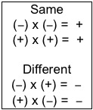
Law of Signs

Slide 11
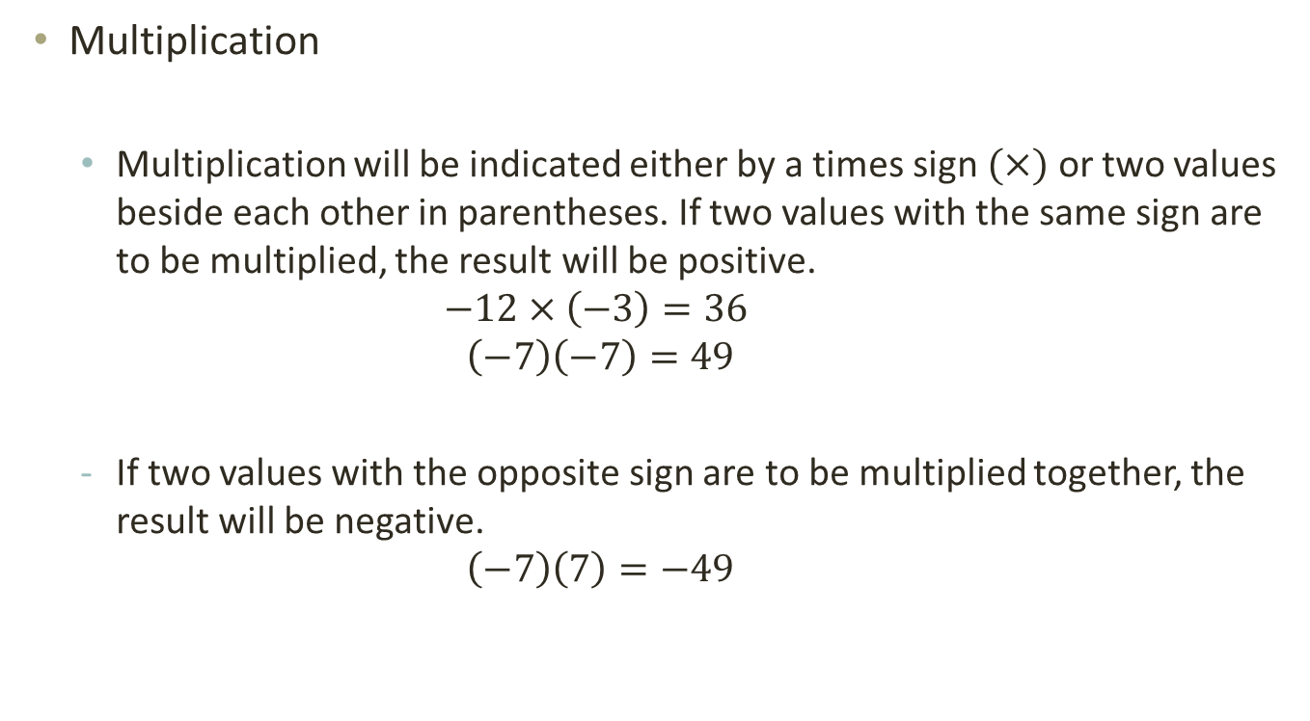
Multiplication
Multiplication will be indicated either by a times sign $(×)$ or two values beside each other in parentheses. If two values with the same sign are to be multiplied, the result will be positive.
$$−12×\left(−3\right)=36$$
$$\left(−7\right)\left(−7\right)=49$$
If two values with the opposite sign are to be multiplied together, the result will be negative.
$$\left(−7\right)\left(7\right)=−49$$

Slide 12
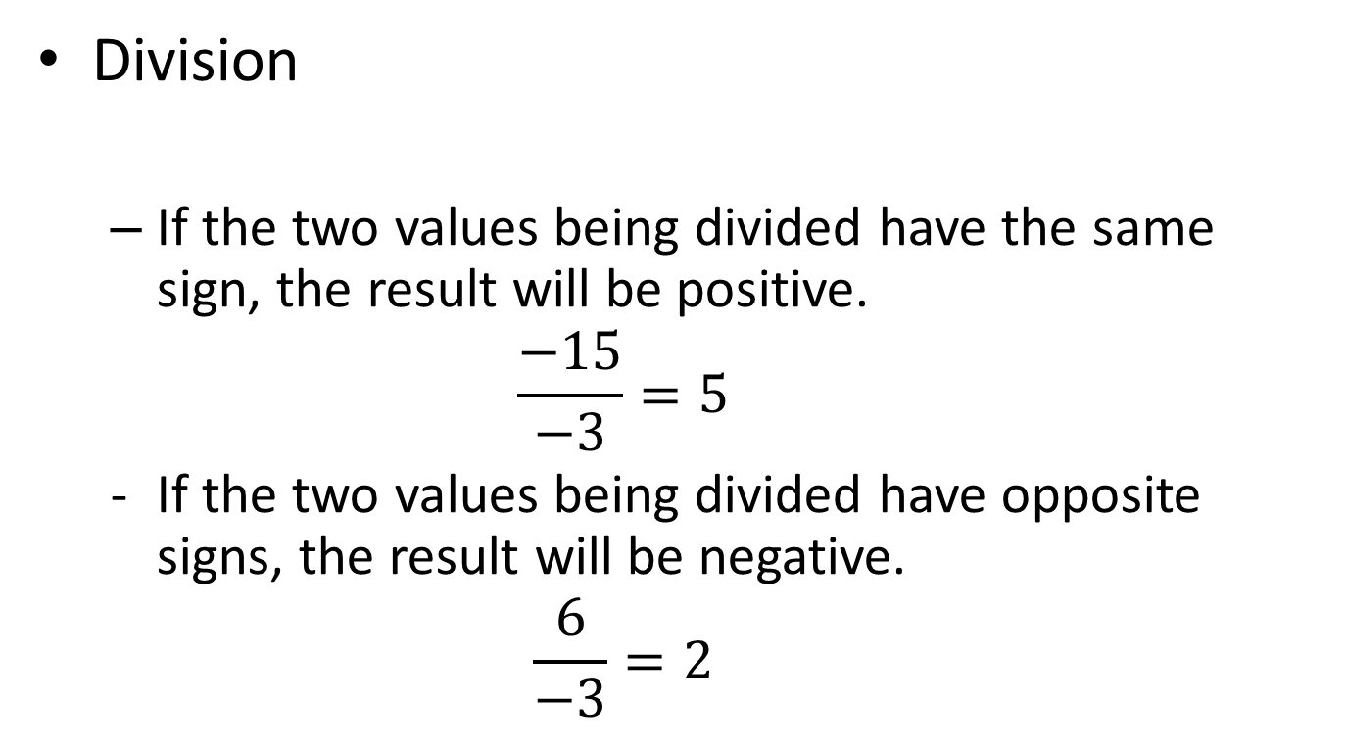

Slide 13
Order of Operations
PEMDAS?
Parenthesis
Exponent
Multiplication
Division
Addition
Subtraction

Slide 14
Examples (PEMDAS)
Compute all values that are in parenthesis first
Brackets and parentheses may be used interchangeably
Parenthesis may also be nested inside brackets.
If this kind of nesting occurs, compute values in the innermost parentheses first.
7 x [4-(3x6)]

Slide 15
PEMDAS cont.…
Exponents
4 + (9 x 3) + (6-4²)

Slide 16
PEMDAS cont.…
After parentheses and exponents have been taken care of, multiplication and division (from left to right) are next.
Addition and subtraction (from left to right) are performed last.
(-7+4²) x 2 – [(3 x 6)/2]

Slide 17
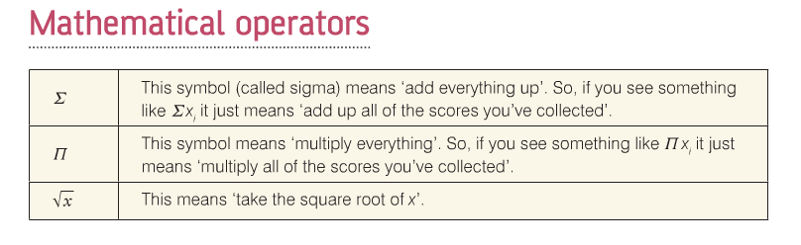

Slide 18


Summation Operator
The summation operator is a useful shorthand for manipulating expressions involving the sum of many numbers.
If $\left\{x_{i}:i=1,...,n\right\}$ denotes a sequence of $n$numbers then we write the sum of these numbers as

Slide 19
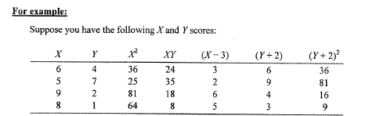

Slide 20
Exercises
Notes:
Caret: ^

Slide 21
Exercises (Answers)
-216
100
100
3
9
7
6
5
30
17
-2

